Slide 1
Meet the code ninjas
Dean Narendra
Nikola Chobanov
Tao Hua
Coen Stange
Bilger Yahov

Slide 2
Introduction
Notes:
Introduction to the team. Introduction to the subject, 4th year project.

Slide 3

Do you like adventures?
Bill Anderson does, so do we!
Now we also know how to capture them!
Notes:
A short story about the “Show me” project and the main idea behind it.

Slide 4
Way of working

Slide 5
“Great things in business are never done by one person,
they are done by a team of people”
–Steve Jobs

Slide 6
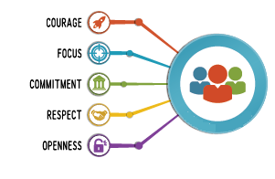
way of working

Slide 7
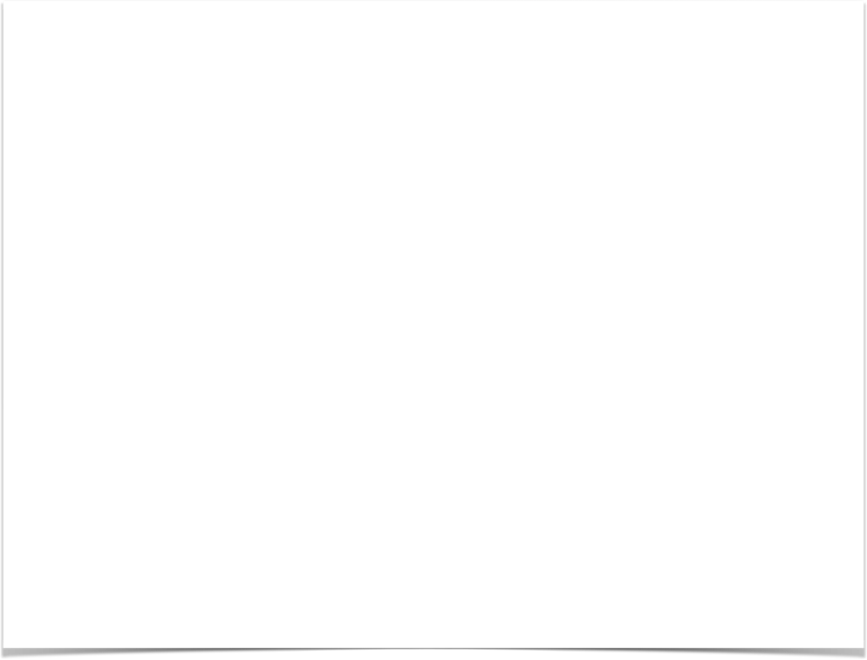
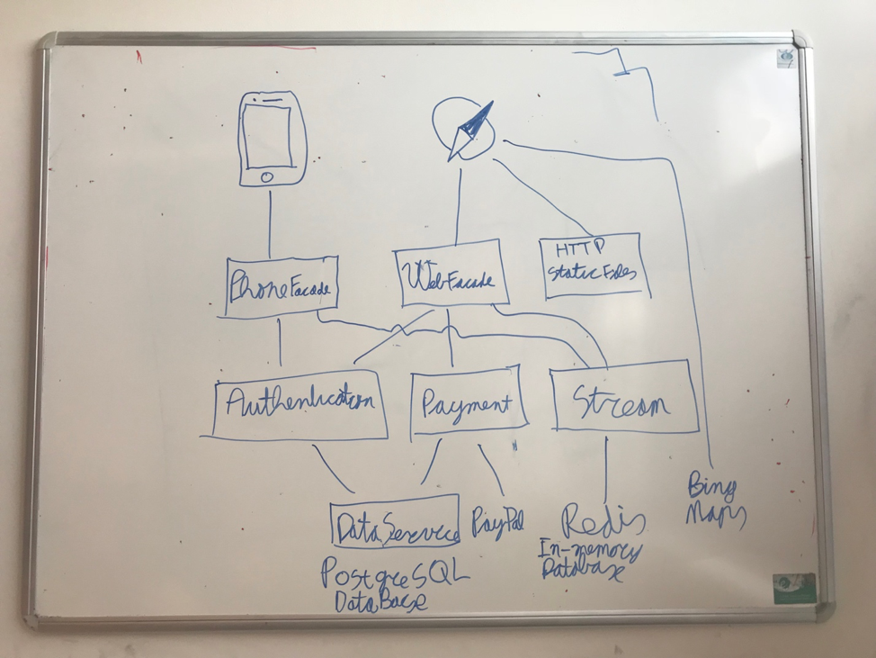
Software architecture

Slide 8

Docker
Make distributed system more easy!
Each application runs inside a container
Publicly available containers like PostgreSQL and Redis
Run the whole system and test the whole system
No need of mock tests, no problems with compatibility in production

Slide 9

Travis-Ci
Continuous integration
Tests triggered by commits
Automatic deploy after passed tests

Slide 10


Current hosting
Distributed System
(Docker)
Static Files
(Web-app)

Slide 11

GraphQL
The better REST-api
Less round-trips to server
Client is less dependent on server
Client describes to the server what data it wants (Query language)

Slide 12
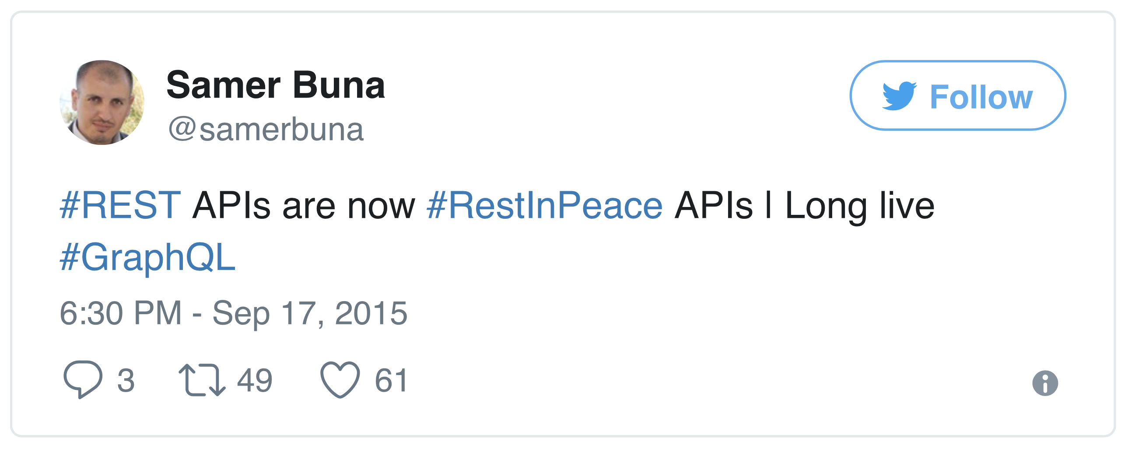

Slide 13


